Slide 1
Error Detection & Correction
Prepared by
Divya K S
Adi Shankara Institute of Engineering & Technology
Kalady

Slide 2
Error
A condition when the receiver’s information does not match with the sender’s information.
During transmission, digital signals suffer from noise that can introduce errors in the binary bits travelling from sender to receiver.
That means a 0 bit may change to 1 or a 1 bit may change to 0.

Slide 3
Types of Errors
Errors can be of three types, namely
single bit errors
multiple bit errors
burst errors.

Slide 4
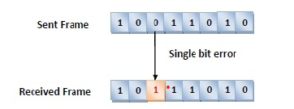
Single bit error
In the received frame, only one bit has been corrupted, i.e. either changed from 0 to 1 or from 1 to 0.

Slide 5
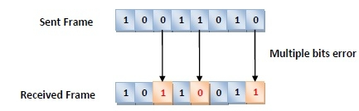
Multiple bits error
In the received frame, more than one bits are corrupted.

Slide 6
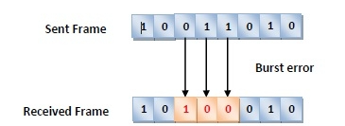
Burst error
In the received frame, more than one consecutive bits are corrupted

Slide 7
Error Control
Error control can be done in two ways
Error detection −
Error detection involves checking whether any error has occurred or not.
not interested in the number of errors. A single-bit error is the same for us as a burst error
Error correction −
In error correction, we need to know the exact number of bits that are corrupted and more importantly, their location in the message.
The number of the errors and the size of the message are important factors.

Slide 8
Error detection
Basic approach is the use of redundancy bits, where additional bits are added to facilitate detection of errors.
Every data unit is send twice
Receiving device would then be able to do a bit by bit comparison between the two versions of data
Any mismatch would an error

Slide 9
Error detection-Redundancy check
Disadvantage
Transmission time and bandwidth becomes doubled.
Therefore instead of repeating the entire data stream,a shorter group of bits may be appended to end of each bit
This technique is called redundancy because the extra bits are redundant to the information and they are discarded

Slide 10
Error detection
Three types of redundancy checks are common in data communication
Parity check
Checksum
Cyclic redundancy check

Slide 11
Cyclic redundancy check-CRC
CRC is a redundancy error technique used to determine the error
It is based on binary division.
CRC uses Generator Polynomial which is available on both sender and receiver side.
Generator Polynomials are used to generate the divisor.
An example generator polynomial is of the form like x³ + x + 1. This generator polynomial represents key 1011.
Another example is x² + 1 that represents key 101.

Slide 12
Properties Of CRC Generator
The algebraic polynomial chosen as a CRC generator should have at least the following properties-
Rule-01:
It should not be divisible by x.
This condition guarantees that all the burst errors of length equal to the length of polynomial are detected.
Rule-02:
It should be divisible by x+1.
This condition guarantees that all the burst errors affecting an odd number of bits are detected.

Slide 13
STEPS IN CRC- At sender
Let n be the number of bits in divisor
A string of n-1 zeros is appended to the data unit
Newly extended data is divided by a divisor(generator polynomial) using a process is known as binary division.
The remainder generated from this division is known as CRC remainder.
Replace the appended 0s at the end of the original data with CRC remainder .
This newly formed code word (Original data + CRC) is transmitted to the receiver.

Slide 14
STEPS IN CRC- At Receiver
The receiver receives the data followed by the CRC remainder.
The receiver will treat this whole unit as a single unit, and it is divided by the same divisor that was used to find the CRC remainder.
On division If the remainder is zero,
Receiver assumes that no error occurred in the data during the transmission.
Receiver accepts the data.
If the remainder is non-zero,
Receiver assumes that some error occurred in the data during the transmission.
Receiver rejects the data and asks the sender for retransmission.

Slide 15
Example -CRC
Data word is 1001 and the divisor is x³+x+ 1
The generator polynomial G(x) x³+x+ 1 (x³ + 0x² + x + 1 )is encoded as 1011 .
The generator polynomial consists of 4 bits.
So, a string of 3 zeroes is appended to the bit stream to be transmitted.
The resulting bit stream is 1001000.

Slide 16
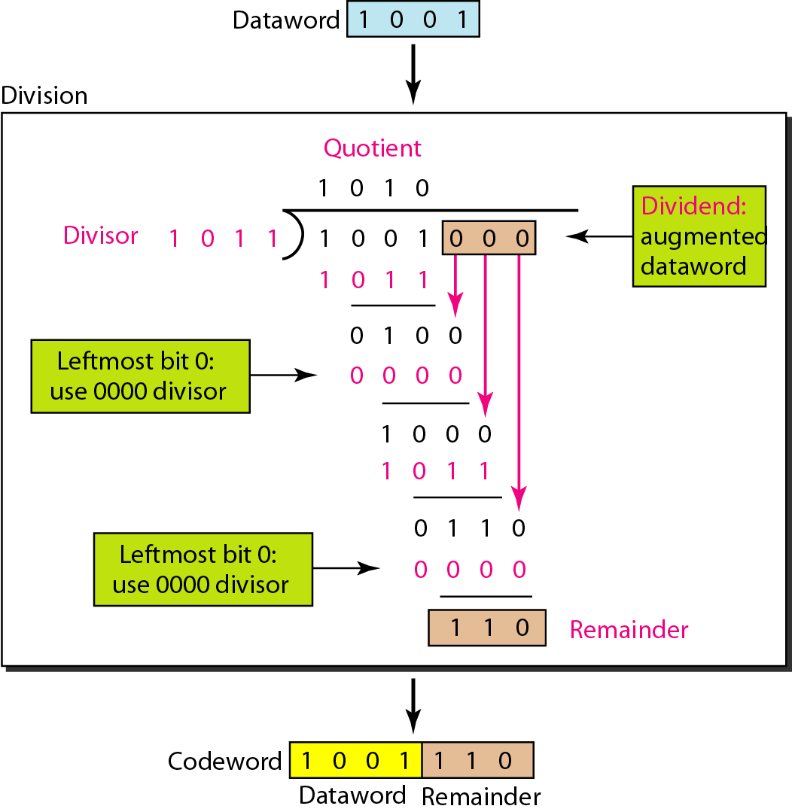
At sender

Slide 17
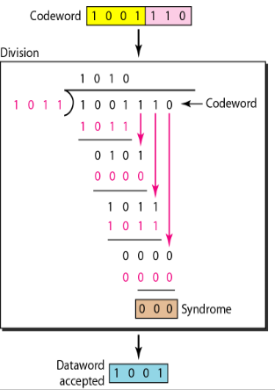
At receiver

Slide 18
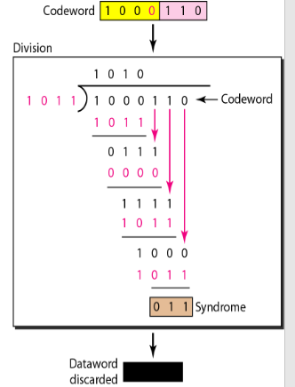
Suppose in previous example the fourth bit from the left is inverted during transmission. Show that this error is detected at the receiver's end.

Slide 19
Example -CRC
Suppose the original data is 11100 and divisor is x³ + 1
The generator polynomial G(x) x³ + 1 (x³ + 0x² + 0x¹ + 1 )is encoded as 1001.
Clearly, the generator polynomial consists of 4 bits.
So, a string of 3 zeroes is appended to the bit stream to be transmitted.
The resulting bit stream is 11100000.

Slide 20
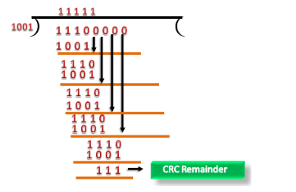
CRC remainder replaces the appended string of 0s at the end of the data unit, and the final string would be 11100111 which is sent across the network.

Slide 21
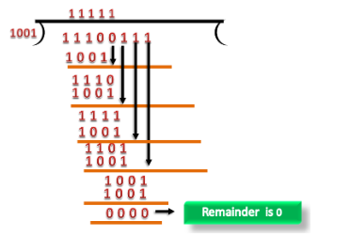
At Receiver
CRC checker generates the remainder of zero. Therefore, the data is accepted.

Slide 22
Questions
What is the remainder obtained by dividing x7 + x5 + 1 by the generator polynomial x³ + 1?
A bit stream 10011101 is transmitted using the standard CRC method. The generator polynomial is x³ + 1. Show the actual bit string transmitted.
Suppose the third bit from the left is inverted during transmission. Show that this error is detected at the receiver's end.

Slide 23
Questions
What is the remainder obtained by dividing x7 + x5 + 1 by the generator polynomial x3 + 1?
The remainder is x 2 + x + 1.

Slide 24
Questions
.A bit stream 10011101 is transmitted using the standard CRC method described in the text. The generator polynomial is x3 + 1. Show the actual bit string transmitted. Suppose the third bit from the left is inverted during transmission. Show that this error is detected at the receiver's end.
Ans :
The frame is 10011101. The generator is 1001. The message after appending three zeros is 10011101000. The remainder on dividing 10011101000 by 1001 is 100. So, the actual bit string transmitted is 10011101100. The received bit stream with an error in the third bit from the left is 10111101100. Dividing this by 1001 produces a remainder of 100, which is different from 0.Thus, the receiver detects the error and can ask for a retransmission. If the transmitted bit stream is converted to any multiple of 1001, the error will not be detected. A trivial example is if all ones in the bit stream are inverted to zeros.

Slide 25
Questions
A bit stream 10101010 is transmitted using the standard CRC method. The generator polynomial is x3 +x2 +1. Show the actual bit string transmitted. Suppose the second bit from the left is inverted during transmission. Show that this error is detected at the receiver’s end.

Slide 26
Data link protocols almost always put the CRC in a trailer rather than in a header. Why?
The CRC is computed during transmission and appended to the output stream as soon as the last bit goes out onto the wire. If the CRC were in the header, it would be necessary to make a pass over the frame to compute the CRC before transmitting. This would require each byte to be handled twice— once for checksumming and once for transmitting. Using the trailer cuts the work in half.

Slide 27
Parity Check
The parity check is done by adding an extra bit, called parity bit to the original data .
Parity bit helps to check if any error occurred in the data during the transmission.
The two types of parity checking are
Even Parity
Odd Parity

Slide 28
Parity Check
The two types of parity checking are
Even Parity − The total number of 1’s in the data unit is made even in case of even parity.
Odd Parity − The total number of 1’s in the data unit is made odd in case of odd parity.

Slide 29
Steps at sender
Total number of 1’s in the data unit to be transmitted is counted.
The total number of 1’s in the data unit is made even in case of even parity or
The total number of 1’s in the data unit is made odd in case of odd parity.This is done by adding an extra bit called as parity bit.
The newly formed code word (Original data + parity bit) is transmitted to the receiver.

Slide 30
Steps at Receiver
At receiver side,
Receiver receives the transmitted code word.
The total number of 1’s in the received code word is counted.
Then, following cases are possible-
If total number of 1’s is even and even parity is used, then receiver assumes that no error occurred.
If total number of 1’s is odd and even parity is used, then receiver assumes that error occurred.
If total number of 1’s is even and odd parity is used, then receiver assumes that error occurred.
If total number of 1’s is odd and odd parity is used, then receiver assumes that no error occurred.

Slide 31
Parity Check Example
Consider the data unit to be transmitted is 1001001 and even parity is used.

Slide 32
Parity Check Example
Consider the data unit to be transmitted is 1001001 and even parity is used.
At Sender Side-
Total number of 1’s in the data unit is counted.
Total number of 1’s in the data unit = 3.
Clearly, even parity is used and total number of 1’s is odd.
So, parity bit = 1 is added to the data unit to make total number of 1’s even.
Then, the code word 10010011 is transmitted to the receiver.

Slide 33
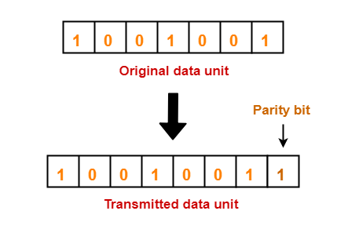
Parity Check Example
At Receiver Side-
After receiving the code word, total number of 1’s in the code word is counted.
Consider receiver receives the correct code word = 10010011.
Even parity is used and total number of 1’s is even.
So, receiver assumes that no error occurred in the data during the transmission.

Slide 34
Limitation
This technique can not detect an even number of bit errors (two, four, six and so on).
If even number of bits flip during transmission, then receiver can not catch the error.
EXAMPLE
Consider the data unit to be transmitted is 10010001 and even parity is used.
Then, code word transmitted to the receiver = 100100011
Consider during transmission, code word modifies as 101100111. (2 bits flip)
On receiving the modified code word, receiver finds the number of 1’s is even and even parity is used.
So, receiver assumes that no error occurred in the data during transmission though the data is corrupted.

Slide 35
Checksum
Error detection method based on redundancy
Step - At sender side
If m bit checksum is used, the data unit to be transmitted is divided into segments of m bits.
All the m bit segments are added.(Add carry to sum if any)
The result of the sum is then complemented using 1’s complement arithmetic.
The value so obtained is called as checksum.
The data along with the checksum value is transmitted to the receiver.

Slide 36
Checksum- At receiver side
The received data unit is divided into segments of m bits.
All the m bit segments are added along with the checksum value.
The value so obtained is complemented and the result is checked.
Then, following two cases are possible-
If the result is zero,
Receiver assumes that no error occurred in the data during the transmission.
Receiver accepts the data.
If the result is non-zero,
Receiver assumes that error occurred in the data during the transmission.
Receiver discards the data and asks the sender for retransmission.

Slide 37
Question
Suppose that a message 1010100100111001 is transmitted using Checksum method (8-bit word). What is the value of the checksum?
Also verify that the data is received at the receiver with out any error.

Slide 38
Solution
At sender
Sum = 10101001 + 00111001 =11100010
Compliment =00011101
Checksum=00011101
Data transmitted is 101010010011100100011101
At receiver
Find the sum of 10101001 + 00111001 + 00011101
Sum= 11111111
Compliment is 00000000 ,Since it is zero no error has occured during transmission

Slide 39
Question
Suppose that a message 1001110010100011 is transmitted using Internet Checksum (4-bit word). What is the value of the checksum?
Also verify that the data is received at the receiver with out any error.

Slide 40
Solution
Suppose that a message 1001 1100 1010 0011 is transmitted using Internet Checksum (4-bit word). What is the value of the checksum?
At sender
Sum = 1001 + 1100 + 1010 + 0011=0100
Compliment =1011
Checksum=1011
Data transmitted is 1001 1100 1010 0011 1011
At receiver
Find the sum of 1001 + 1100 + 1010 + 0011 + 1011
Sum=1111
Compliment is 0000 ,Since it is zero no error has occured during transmission

Slide 41
Question 2
Consider the data unit to be transmitted is-
10011001111000100010010010000100
Consider 8 bit checksum is used.

Slide 42
Solution
At sender side,
The given data unit is divided into segments of 8 bits
Now, all the segments are added and the result is obtained as-
10011001 + 11100010 + 00100100 + 10000100 = 1000100011
Since the result consists of 10 bits, so extra 2 bits are wrapped around.
00100011 + 10 = 00100101 (8 bits)
Now, 1’s complement is taken which is 11011010.
Thus, checksum value = 11011010
The data along with the checksum value is transmitted to the receiver.
At receiver side,
The received data unit is divided into segments of 8 bits.
All the segments along with the checksum value are added.
Sum of all segments + Checksum value = 00100101 + 11011010 = 11111111
Complemented value = 00000000
Since the result is 0, receiver assumes no error occurred in the data and therefore accepts it.

